Slide 1
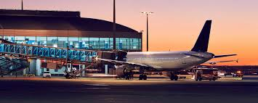
Airline Management System

Slide 2
Submitted To
Mohammad Arafat
Assistant Lecturer
Dept. of CSE
Submitted By
Ibrahim Khalilullah
Id : C233209
Dept. of CSE
Sajid Mahmud
Id : C233211
Dept. of CSE
Mohammad Rakibul Islam
Id : C233213
Dept. of CSE

Slide 3
Introduction
This project focuses on the design of an Airline Management System as a part of our Computer Programming II course
Overview:
The Airline Management System is a C++ command-line application that simplifies user registration, flight booking, and account management. Users can sign up, log in, search for flights, and book tickets with prices based on distance, class, and loyalty points. It also enables users to view their account details and provides a helpline for booking or general assistance. The system is designed for future expansion, including features like payment integration and a graphical interface.
Purpose:
The purpose of this project is to apply software development concepts to solve a practical problem and understand the functioning of user management, flight booking, and account handling in an airline system.

Slide 4
Objective
User Registration and Login: Users can register and log in to access personalized flight-related services.
Flight Search and Booking: Users can search for available flights based on their preferences and book tickets online.
Account Management: Users can view and manage their account details, including personal information and booking history.
Helpline and Assistance: A helpline feature is provided for users to get assistance with issues or queries.
System Interaction: The system offers a smooth and intuitive interaction through the command line interface.

Slide 5
Methodology
Start
Menu
Sign up
Log in
View Flight
Search Flight
Book Flight
View Account
Help Line

Slide 6
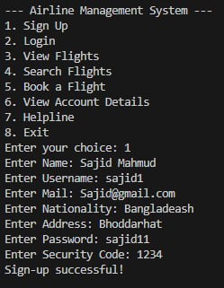
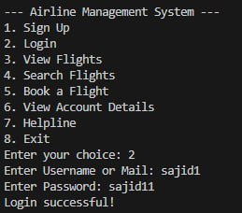
Key Features
Sign Up – Handles user registration here the information :-
1. Name
2.Username
3.Mail
4.Nationality
5.Address
6.Password
7.Security Code
Login – Manages users login and the information are
1.Username or Mail
2.Password

Slide 7
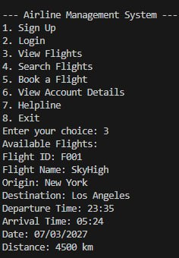
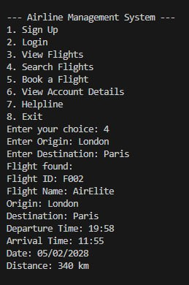
View Flights – Displays available flights .
Search Flights – Allows users to search for flights based on their criteria and here the information are
Origin
Destination

Slide 8
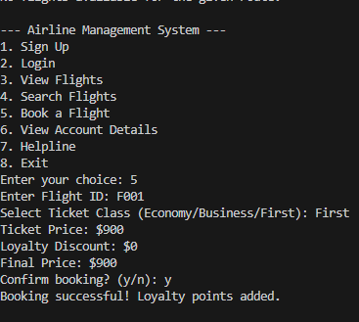
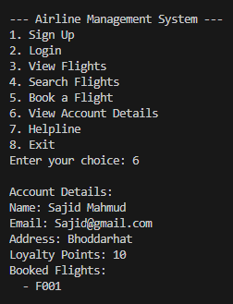
Book Flight –
Facilitates flight booking.
Account Details – Displays user account information like :
1.Name
2.Email
3.Address
4.Loyalty Points
5.Booked Flights

Slide 9
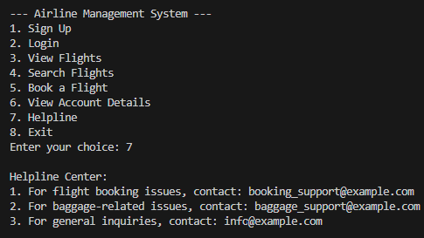
Helpline :
Provide assistance for user inquiries and issues and ensure a smooth user experience for flight-related operations.
Support Options are Flight Booking Issues , Baggage Support and General Inquiries by Dedicated email addresses for different categories of issues (e.g., booking_support@example.com).
Exit :
End Function

Slide 10
Future Work
Graphical User Interface (GUI): Implementing a GUI would enhance the user experience with a more intuitive and visually appealing interface.
Database Integration: Integrating a backend database would store user data, flight schedules, and booking information, ensuring persistent data across sessions.
Payment Gateway Integration: Adding a payment gateway would allow users to complete flight bookings with online payment processing.
Flight Cancellation and Modification: The system could enable users to cancel or modify their bookings, a necessary feature for real-world applications.
Multi-Language Support: Implementing multi-language support would make the system accessible to non-English speaking users.

Slide 11
conclusion
we would like to thank you for your time and attention as we showcased our Airlines Management System. This project has been a journey of learning and growth for our team.
Through this system, we aimed to provide an efficient and user-friendly platform for airline management, integrating key features such as user registration, login,Flight Details Flight search, booking, account management, loyalty rewards, and a dedicated helpline. We also implemented features like random flight generation to simulate real-world scenarios.
Once again, thank you for your interest and support in our work. We hope this project reflects not just our technical capabilities but also our passion for creating impactful solutions. We’re happy to answer any questions you may have.
Thank you

Slide 12

Thank You

